Slide 1
Topic: Sketching Quadratic Functions
EQ: How do I sketch a qudartic function without a table of values?

Slide 2
Quadratic Functions
parabola
The graph of a quadratic function is a:
y
A parabola can open up or down.
Vertex
If the parabola opens up, the lowest point is called the vertex (minimum).
x
If the parabola opens down, the vertex is the highest point (maximum).
Vertex
NOTE: if the parabola opens left or right it is not a function!
Notes:
Let students know that in Algebra I we concentrate only on parabolas that are functions; In Algebra II, they will study parabolas that open left or right.

Slide 3
Standard Form
The standard form of a quadratic function is:
y = ax² + bx + c
y
The parabola will open up when the a value is positive.
a > 0
The parabola will open down when the a value is negative.
x
a < 0
Notes:
Remind students that if ‘a’ = 0 you would not have a quadratic function.

Slide 4
Axis of Symmetry
Parabolas are symmetric.
If we drew a line down the middle of the parabola, we could fold the parabola in half.
y
Axis of Symmetry
We call this line the Axis of symmetry.
x
If we graph one side of the parabola, we could REFLECT it over the Axis of symmetry to graph the other side.
The Axis of symmetry ALWAYS passes through the vertex.

Slide 5
Graphing a Quadratic Function
There are 4 steps to graphing a parabola in standard form.
STEP 1: Find the Axis of symmetry using:
STEP 2: Find the vertex (Turning Point)
STEP 3: Find the x-intercepts (where it crosses the x-axis)
STEP 3: Find the y-intercepts (where it crosses the y-axis)

Slide 6
Example 1: Sketch f(x) = x² - 7x + 6
Step 1 : Find the axis of symmetry
x = 3.5
Step 2: Find the vertex (TP)
(3.5, -6.25)
Step 3: Find the x-intercepts
(1, 0) and (6, 0)
Step 4: Find the y-intercept
(0, 6)
Now you can sketch your function!!

Slide 7

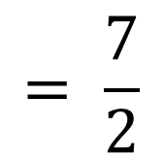
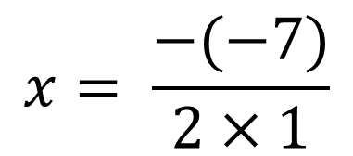
Finding the Axis of Symmetry
When a quadratic function is in standard form
y = ax² + bx + c,
the equation of the Axis of symmetry is
This is best read as …
‘the opposite of b divided by the quantity of 2 times a.’
Find the Axis of symmetry for f(x) = x² - 7x + 6
a = 1 b = -7
The Axis of symmetry is x = 3.5
$$x= \frac{−(−7)}{2×1}$$
$$= \frac{7}{2}$$
$$=3.5$$
Notes:
Discuss with the students that the line of symmetry of a quadratic function (parabola that opens up or down) is always a vertical line, therefore has the equation x =#. Ask “Does this parabola open up or down?

Slide 8
Finding the Vertex
The Axis of symmetry always goes through the _______. Thus, the Axis of symmetry gives us the ____________ of the vertex.
Vertex
X-coordinate
Find the vertex of f(x) = x² - 7x + 6
STEP 1: Find the Axis of symmetry:
The x-coordinate of the vertex is 3.5
STEP 2: Substitute the x – value into the original equation to find the y –coordinate of the vertex.
The vertex is (2 , 5)

Slide 9
Finding the x-intercepts
Find where the function crosses the x – axis.
f(x) = x² - 7x + 6
The function crosses the x-axis when y=0
0 = x² - 7x + 6
Now factorise.
0 = x² - 7x + 6
= (x – 1)(x – 6)
So: x = 1, 6
(1,0) and (6,0)
Find two numbers that ×to give 6 and + to give -7

Slide 10


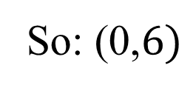

Finding the y-intercept
Find where the function crosses the y – axis.
f(x) = x² - 7x + 6
The function crosses the y-axis when x=0
$$f\left(x\right)=0^{2} −7×0+6$$
$$f\left(x\right)=0^{2} −0+6$$
$$f\left(x\right)=6$$
The constant term is always the y- intercept
So: (0,$6)$

Slide 11
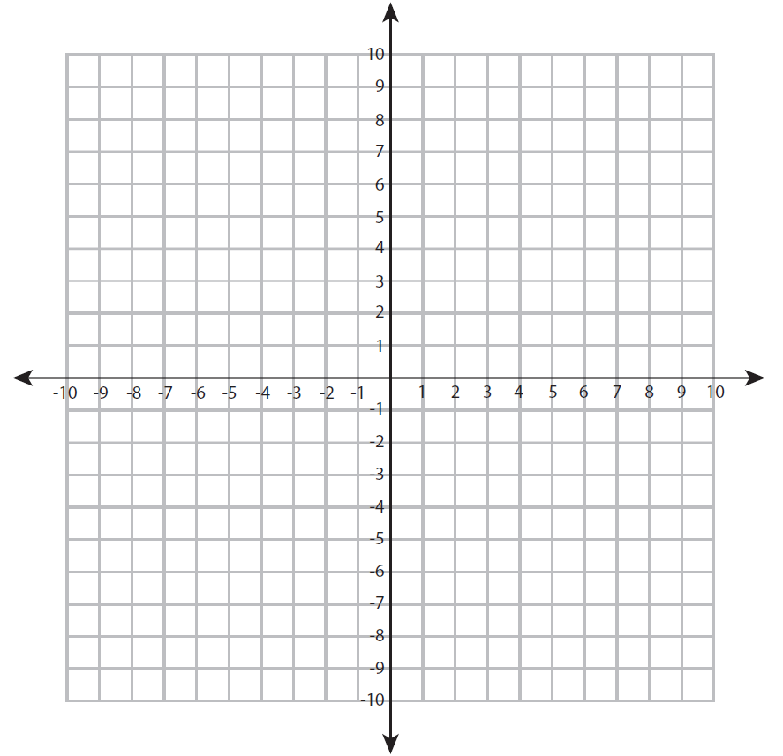
Sketching your parabola
y-intercept
x-intercepts
Line of symmetry
Vertex (Turning Point)
Minimum

Slide 12
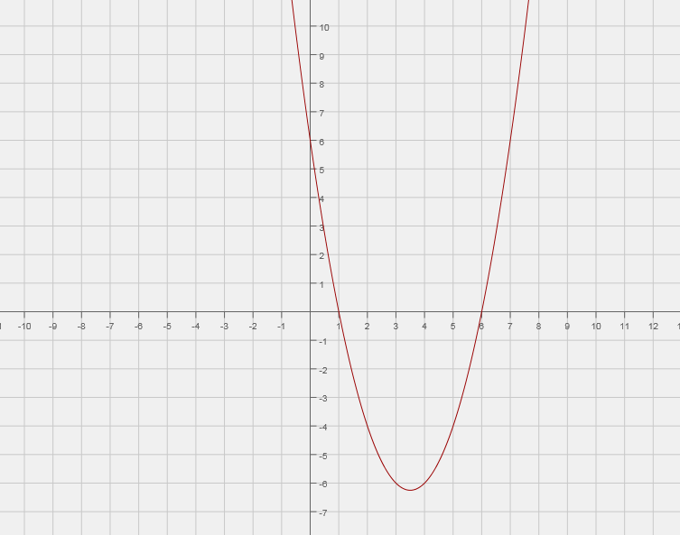
Sketching your parabola

Slide 13
Solving a Quadratic
The x-intercepts (when y = 0) of a quadratic function
are the solutions to the related quadratic equation.
The number of real solutions is at most two.
No solutions
One solution
X = 3
Two solutions
X= -2 or X = 2
Notes:
Remind students that x-intercepts are found by setting y = 0 therefore the related equation would be ax²+bx+c=0. Also state that since the highest degree of a quadratic is 2, then there are at most 2 solutions. For the first graph ask “why are there no solutions?”-- there are no solutions because the parabola does not intercept the x-axis. 2nd and 3rd graph ask students to state the solutions. Additional Vocab may be itroduced: The x-intercepts are solutions, zero’s or roots of the equation.

